Slide 1

DIGITAL EXHAUST
DIGITAL EXHAUST
Metadata Privacy Risks h Mitigation via MAT2
Introduction to Cybersecurity
Department of Cybersecurity

Slide 2
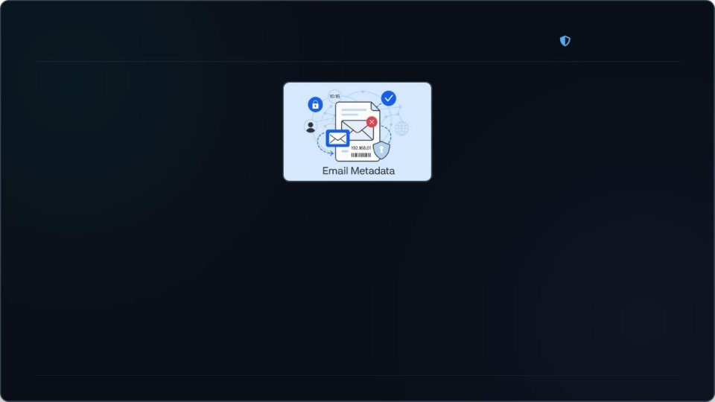
What Is Metadata? 01 / Concepts
DIGITAL EXHAUST
Definition: Data about data hidden inside digital files.
Envelope Analogy: Message is private, envelope exposes sender, date, and tracking details.
EXIF Data: Image files contain GPS logs, timestamps, and device camera models.
Document Files: Elements store author names, software revisions, and internal edit histories. Accessibility: Metadata is completely invisible to casual viewers but easily extracted by attackers.
Slide 02 / 07

Slide 3

Introduction to MAT2 02 / Toolsets
DIGITAL EXHAUST
MAT2 refers directly to the Metadata Anonymisation Toolkit.
Free, open-source, Python-based, and community-audited privacy cleaning software.
Core Principle: Removes hidden metadata layers while leaving visible content completely untouched. Targets: Securely flushes GPS records, device profiles, author signatures, and embedded thumbnails.
Slide 03 / 07

Slide 4

How MAT2 Works 03 / System Architecture
DIGITAL EXHAUST
Mount Binary
Extract Stream
Reconstruct Wrapper
Output
.cleaned
Mount: Loads original source target securely directly into temporary volatile system memory.
Extract: Discards the dirty legacy container and pulls only purified raw content streams. Reconstruct: Writes an entirely new, structurally sterile file wrapper around the clean stream. Output: Saves a safe sanitized copy appending the secure .cleaned extension.
Limitations: Cannot process cryptographic DRM protections or complex interleaved video structures.
Slide 04 / 07

Slide 5

Using MAT2 – GUI Method 04 / Workflows
DIGITAL EXHAUST
Simple interface specifically optimized for non-technical users and general oﬃce staff.
Drag and drop documents directly into the mut2−gui active scanning grid.
Process multiple batch files simultaneously with a single click of the Clean button.
Original source files remain completely untouched, providing secure non-destructive workflows.
Slide 05 / 07

Slide 6

Using MAT2 – CLI Method 05 / Technical Workflows
DIGITAL EXHAUST
sec-analyst@kali:~/documents
$ mat2 --show document.pdf
[+] File: document.pdf | Author: Administrator | Software: Acrobat Writer
$ mat2 document.pdf
[+] Purging metadata... output generated: document.cleaned.pdf
High-performance interface designed for cybersecurity analysts, administrators, and automated security pipelines.
Inspect hidden metadata layers using command line query: mat2 --show filsnums.jpg Instantly strip metadata and generate a clean duplicate using command: mat2 filsnums.pdf Seamlessly integrates with SOC playbooks, automated forensics networks, and bulk scripts.
Slide 06 / 07

Slide 7

Conclusion & Key Takeaways 06 / Wrap Up
DIGITAL EXHAUST
Executive Summary
Digital exhaust presents a hidden, persistent vulnerability to personal and organizational privacy. Metadata reveals sensitive geographic, device, and behavioral indicators without consent.
The MAT2 tool offers an eﬃcient, automated defense for cleaning files.
Proactive data hygiene must become a standard operational practice before sharing.
Any Questions?
We welcome your live questions regarding Metadata Privacy, MAT2, and Defensive Workflows
Slide 07 / 07

Slide 8

Image Sources
https://img.freepik.com/premium-vector/global-cybersecurity-network-background-with-world-map-data-connections_7
03032−8732.jpg
Source: www.freepik.com
https://www.inboxally.com/wp-content/uploads/2025/02/email-metadata.png
Source: www.inboxally.com
https://static.vecteezy.com/system/resources/previews/067/868/466/non_2×/secure-shield-icons-protection-and-privacy
-a-shield-with-a-locked-padlock-it-network-communication-technology-icon-vector.jpg
Source: www.vecteezy.com
https://www.visily.ai/wp-content/uploads/2025/03/How-Does-a-Drag-and-Drop-Wireframe-Tool-Work_-1024×673.jpg
Source: www.visily.ai

